Slide 1

American Society of Hematology 2022
Select Presentations of Interest for Leukemia
SC-AT-AMG103-00429 03.25

Slide 2
ASH 2022
Select a Topic
Amgen Sponsored
Blinatumomab Studies
Non-Amgen Sponsored Studies
Amgen Sponsored
ALL Studies

Slide 3
Table of Contents:
Select Amgen Sponsored Blinatumomab Studies in B-ALL – ASH 2022
Abstract Number | Title | Type of Presentation
B-ALL Presentations
2727 | Safety and Pharmacokinetics of Subcutaneous Blinatumomab or the Treatment of R/R B-ALL: Results from a Phase 1b Study | Poster
2732 | Blinatumomab Alternating With Low-Intensity Chemotherapy (CT) Treatment for Older Adults With ND Ph (-) B-ALL is Well Tolerated and Efficacious: Safety Run-In Results for the Phase 3 Randomized Controlled Golden Gate Study | Poster
Non-Amgen Sponsored Studies
Amgen Sponsored ALL Studies

Slide 4
Table of Contents:
Select Non-Amgen Sponsored Studies in B-ALL – ASH 2022
Abstract Number | Title | Type of Presentation
LBA-1 | Consolidation Therapy with Blinatumomab Improves Overall Survival in Newly Diagnosed Adult Patients with B-Lineage Acute Lymphoblastic Leukemia in Measurable Residual Disease Negative Remission: Results from the ECOG-ACRIN E1910 Randomized Phase III National Cooperative Clinical Trials Network Trial | Oral
1413 | Single Cycle of Blinatumomab Followed By High-Dose Chemo in the Induction Therapy for Ph(-) ALL in Adults. Primary Endpoint Analysis of the Blina-Cell Trial | Poster
Amgen Sponsored Blinatumomab Studies
Amgen Sponsored ALL Studies

Slide 5
Table of Contents:
Select Amgen Sponsored Studies in B-ALL – ASH 2022
Abstract Number | Title | Type of Presentation
3607 | Patient Characteristics, Treatment Patterns, and Cost Variations By Race/Ethnicity Among Adults with Relapsed or Refractory ALL Initiating First Salvage Therapy | Poster
Amgen Sponsored Blinatumomab Studies
Non-Amgen Sponsored Studies

Slide 6
Amgen Sponsored Blinatumomab Studies
Notes:
6

Slide 7
Safety and pharmacokinetics of subcutaneous (SC) Blinatumomab for the treatment of adults with relapsed or refractory b-cell precursor acute lymphoblastic leukemia (r/r b-all): results from a phase 1b study
Pilar Martínez-Sánchez ¹, Gerhard Zugmaier², Paul Gordon ³, Elias Jabbour⁴, José J Rifón Roca ⁵, Stefan Schwartz ⁶, Erika Borlenghi ⁷, Francoise Huguet ⁸, Jesús María Hernández-Rivas ⁹, Federico Lussana ¹⁰, Céline Berthon ¹¹, Priti Kadu ¹², Hansen Wong ¹³, Ana Markovic ³, Yuliya Katlinskaya ¹³, and Alessandro Rambaldi ^{14,15}
¹ Hematology Department, University Hospital Doce De Octubre, Complutense University, Madrid, Spain; ² Amgen Research GmbH, Munich, Germany; ³ Amgen Inc., Thousand Oaks, CA, USA; ⁴ Department of Leukemia, The University of Texas MD Anderson Cancer Center, Houston, TX, USA; ⁵ Hematology and Cell Therapy Department, Clínica Universidad de Navarra, Pamplona, Spain; ⁶ Hematology, Oncology and Tumor Immunology, Charité-Universitätsmedizin Berlin, corporate member of Freie Universität Berlin and Humboldt-Universität zu Berlin, Berlin, Germany; ⁷ Department of Hematology, ASST Spedali Civili, Brescia, Italy; ⁸ Department of Hematology, Institut Universitaire du Cancer-Oncopole CHU de Toulouse, Toulouse, France; ⁹ Cancer Research Center of Salamanca (USAL-CSIC), Salamanca, Spain; ¹⁰ Department of Oncology-Hematology, Azienda Socio Sanitaria Territoriale Papa Giovanni XXIII, Bergamo, Italy; ¹¹ Cancer Heterogeneity, Plasticity and Resistance to Therapies, Univ. Lille, Lille, France; ¹² IQVIA RDS (India) Private Limited, Bangalore, India; ¹³ Amgen Inc, South San Francisco, CA, USA; ¹⁴ Hematology, ASST Papa Giovanni XXIII, Bergamo, Italy; ¹⁵ Azienda Socio Sanitaria Territoriale Papa Giovanni XXIII Piazza OMS, Bergamo, Italy.

Slide 8
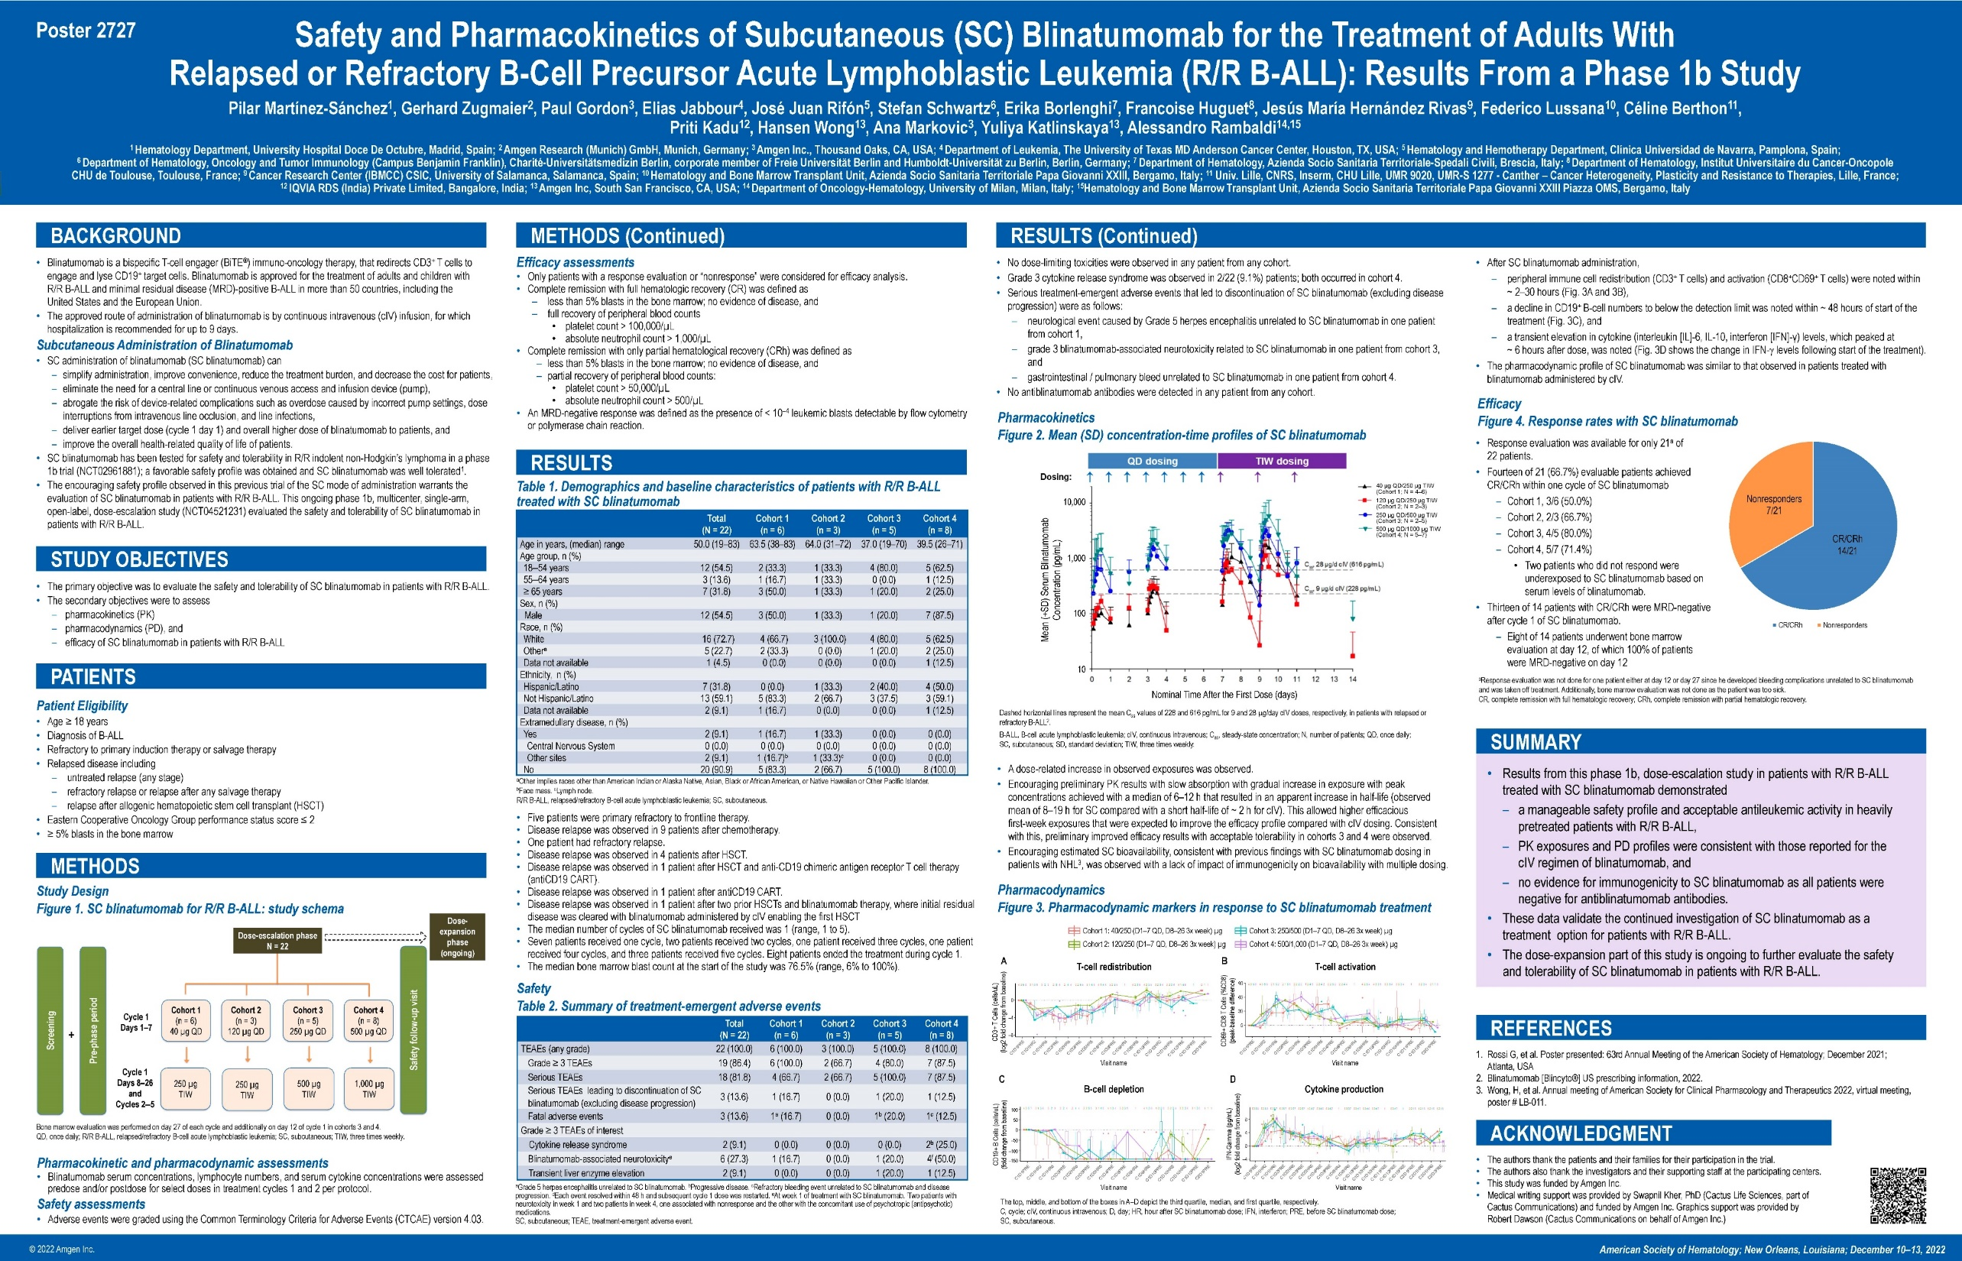
20

Slide 9
Blinatumomab Alternating With Low-Intensity Chemotherapy (CT) Treatment for Older Adults With ND Ph (-) B-ALL is Well Tolerated and Efficacious: Safety Run-In Results for the Phase 3 Randomized Controlled Golden Gate Study
Elias Jabbour¹, Ibrahim Aldoss², Shaun Fleming³, Ashish Bajel⁴, Paul Cannell⁵, Monika Brüggemann⁶, Gerhard Zugmaier⁷, Joan Morris ⁸, Yuqi Chen⁸, Sonny Powar⁹, Hansen Wong¹⁰, Yuliya Katlinskaya⁸, Björn Steffen¹¹, Hagop Kantarjian¹, and Nicola Goekbuget¹¹
¹ MD Anderson Cancer Center, Houston, TX; ² City of Hope, Duarte, CA; ³ The Alfred Hospital, Melbourne, Victoria, Australia; ⁴ Peter MacCallum Cancer Centre and The Royal Melbourne Hospital, Melbourne, Victoria, Australia; ⁵ Fiona Stanley Hospital, Perth, Australia; ⁶ University Medical Center Schleswig-Holstein, Kiel, Germany; ⁷ Amgen Research GmbH, Munich, Germany; ⁸ Amgen Inc., Thousand Oaks, CA; ⁹ Amgen Inc., Uxbridge, United Kingdom; ¹⁰ Amgen Inc., South San Francisco, CA; ¹¹ Goethe University, University Hospital, Department of Medicine II, Frankfurt, Germany

Slide 10
22

Slide 11
Non-Amgen Sponsored Studies
Notes:
11

Slide 12
Consolidation therapy with Blinatumomab improves overall survival in newly diagnosed adult patients with b-lineage acute lymphoblastic leukemia in measurable residual disease negative remission: Results from ecog-acrin e1910 randomized phase Iii national cooperative clinical trials network trial
Mark R Litzow¹, Zhuoxin Sun², Elisabeth Paietta³, Ryan J Mattison⁴, Hillard M Lazarus⁵, Jacob M Rowe⁶, Daniel A Arber⁷, Charles G Mullighan⁸, Cheryl L Willman⁹, Yanming Zhang¹⁰, Matthew Wieduwilt¹¹, Michaela Liedtke¹², Julie Bergeron¹³, Keith W Pratz¹⁴, Shira Dinner¹⁵, Noelle V Frey¹⁶, Steven D Gore¹⁷, Bhavana Bhatnagar¹⁸, Ehab L Atallah¹⁹, Geoffrey L Uy²⁰, Deepa Jeyakumar²¹, Tara L Lin²², Richard F Little²³, Selina M Luger²⁴, and Martin S Tallman²⁵
¹ Division of Hematology, Mayo Clinic, Rochester, MN; ² Dana-Farber Cancer Institute, Boston, MA; ³ Cancer Center, Montefiore Medical Center, Bronx, NY; ⁴ Carbone Comprehensive Cancer Center, Madison, WI
⁵ Adult Hematologic Malignancies & Stem Cell Transplant Section, University Hospitals Cleveland Medical Center, Shaker Heights, OH; ⁶ Department of Hematology, Shaare Zedek Medical Center, Jerusalem, Israel; ⁷ Department of Pathology, The University of Chicago, Chicago, IL; ⁸ Department of Pathology, St. Jude Children's Research Hospital, Memphis, TN; ⁹ Mayo Clinic, Rochester, MN; ¹⁰ Department of Pathology and Laboratory Medicine, Cytogenetics Laboratory, Memorial Sloan Kettering Cancer Center, New York, NY; ¹¹ Stephenson Cancer Center, University of Oklahoma Health Sciences Center, Oklahoma City, OK; ¹² Department of Medicine, Divisions of Oncology and Hematology, Stanford University, Stanford, CA; ¹³ CEMTL installation Maisonneuve-Rosemont, Montreal, QC, Canada; ¹⁴ Department of Medicine, Hematology-Oncology Section, Hospital of the University of Pennsylvania, Philadelphia, PA; ¹⁵ Robert H. Lurie Comprehensive Cancer Center, Northwestern University, Chicago, IL; ¹⁶ Abramson Cancer Center, University of Pennsylvania, Narberth, PA; ¹⁷ Cancer Therapy Evaluation Program, National Cancer Institute, Bethesda, MD; ¹⁸ Department of Hematology and Medical Oncology, West Virginia University Cancer Institute, Wheeling, WV; ¹⁹ Division of Hematology/Oncology, Medical College of Wisconsin, Milwaukee, WI; ²⁰ Division of Oncology, Department of Medicine, Washington University School of Medicine, Saint Louis, MO; ²¹ Division of Hematology/Oncology, UC Irvine Medical Center, Orange, CA; ²² University of Kansas, Westwood, KS; ²³ National Cancer Institute, Washington, DC; ²⁴ Cellular Therapy and Transplantation, Abramson Cancer Center of the University of Pennsylvania, Philadelphia, PA; ²⁵ Robert H. Lurie Comprehensive Cancer Center, Northwestern University and ECOG, Chicago, IL

Slide 13
Introduction
Blinatumomab is a bi-specific T cell engager molecule composed of the variable region of an anti-CD19 antibody linked to the variable region of an anti-CD3 antibody that is FDA approved for relapsed/refractory B-ALL and MRD+ B-ALL in adults and children
The E1910 chemotherapy regimen consisted of:
  2.5 months of a BFM type induction regimen modified from the E2993/UKALLXII protocol
  Pts in CR/CRi then received CNS intensification with high dose methotrexate & pegaspargase
  MRD status was assessed, and patients (pts) were randomized to receive 4 cycles of combination consolidation chemotherapy +/- four 4-week cycles of IV blinatumomab by continuous infusion followed by 2.5 years of POMP maintenance chemotherapy timed from the start of intensification
Reproduced with permission from Litzow MR, et al. Presented at: American Society of Hematology Annual Meeting; December 10-13, 2022; New Orleans, LA, USA.

Slide 14
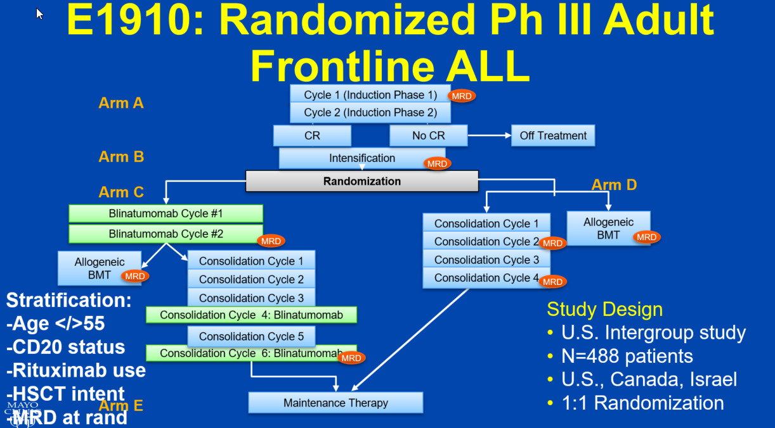
Reproduced with permission from Litzow MR, et al. Presented at: American Society of Hematology Annual Meeting; December 10-13, 2022; New Orleans, LA, USA.

Slide 15
Objectives and Design
Primary objective: Compare overall survival (OS) in MRD- patients who received blinatumomab + chemotherapy (CRx) to that of patients who received CRx alone
Minimum of 190 pts projected to be MRD-, randomized to Step 3
Accrual goal = 488
With 190 MRD negative pts, 80% power to detect 45% reduction in hazard rate in the blinatumomab arm relative to the no blinatumomab arm, using one-sided log rank test at the significance level of 0.025 and assuming 2 years of follow-up
Reproduced with permission from Litzow MR, et al. Presented at: American Society of Hematology Annual Meeting; December 10-13, 2022; New Orleans, LA, USA.

Slide 16
Methods and Results
Measurable residual disease (MRD) assessed centrally by standardized 6 color flow cytometry in the E-A Leukemia Translational Research Laboratory by Elisabeth Paietta, PhD with >0.01% as the cutoff for positivity
488 pts enrolled
Age: median 51, range (30, 70)
CR/CRi rate 395/488 (81%); CR 364 (75%), CRi 31 (6%)
Reproduced with permission from Litzow MR, et al. Presented at: American Society of Hematology Annual Meeting; December 10-13, 2022; New Orleans, LA, USA.

Slide 17
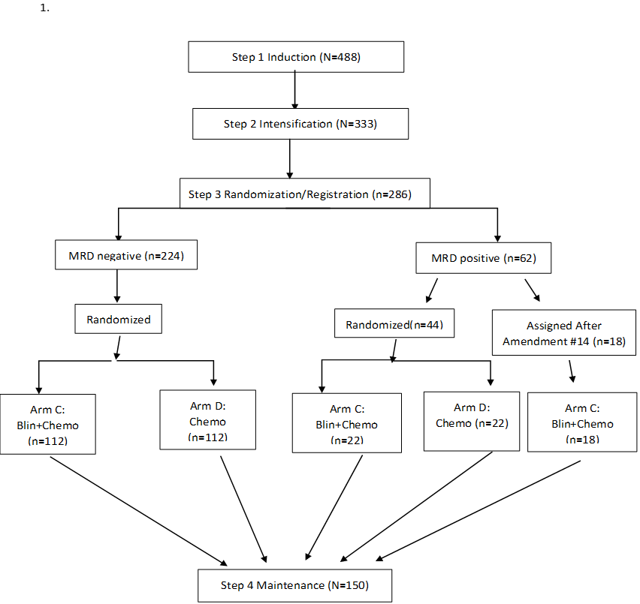
Patient Status
Study Activated: 12/17/2013
Study Terminated: 10/15/2019
286 patients have been randomized/assigned to step 3
(224 MRD-; 62 MRD+)
Baseline characteristics examined were well balanced between arms
*Following FDA approval of blinatumomab for MRD+ disease in March 2018, MRD+ pts were no longer randomized but assigned to Arm C
Reproduced with permission from Litzow MR, et al. Presented at: American Society of Hematology Annual Meeting; December 10-13, 2022; New Orleans, LA, USA.

Slide 18
Third Interim Efficacy Analysis
In September 2022, the ECOG-ACRIN Data Safety Monitoring Committee recommended trial results be released in favor of effectiveness in the MRD- patients
Median follow-up at the time of analysis 43 months (3.6 yrs)
Among the 224 MRD- patients, 22 in each arm underwent allogeneic transplant
80% of pts received 2 or more cycles of blinatumomab
Reproduced with permission from Litzow MR, et al. Presented at: American Society of Hematology Annual Meeting; December 10-13, 2022; New Orleans, LA, USA.

Slide 19
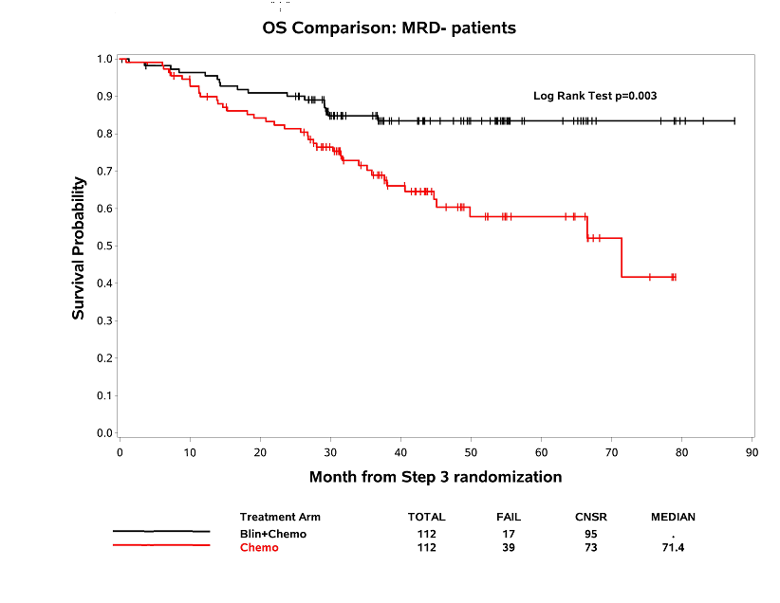
Overall Survival Comparison: MRD negative patients
Median OS: not reached (Blin+Chemo) vs 71.4 mos (Chemo); Hazard ratio 0.42, 95% CI: 0.24-0.75;
Log rank test, p=0.003
Deaths on Blin+Chemo Arm=17 (2° to ALL=8, NRM=9), Chemo Arm=39 (2° to ALL=20, NRM=17, Unknown=2
Reproduced with permission from Litzow MR, et al. Presented at: American Society of Hematology Annual Meeting; December 10-13, 2022; New Orleans, LA, USA.

Slide 20
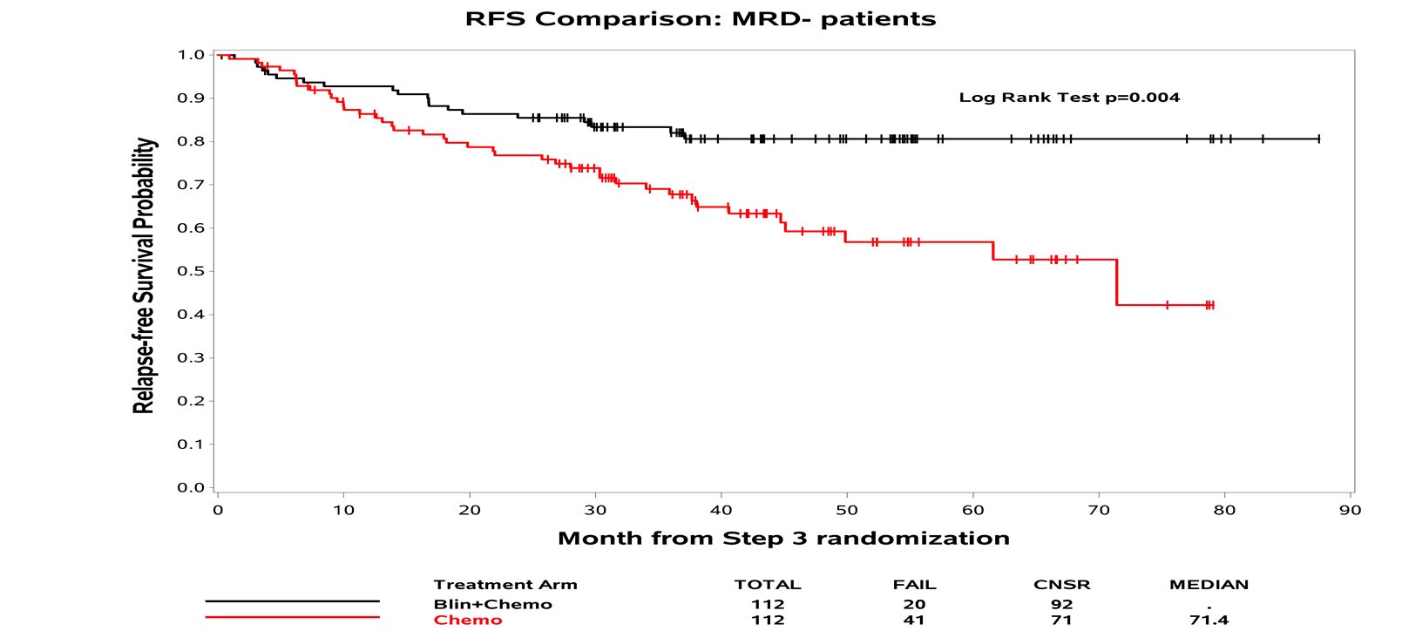
Relapse-Free Survival Comparison: MRD negative patients
Median RFS: not reached (Blin+Chemo) vs. 22.4 months (Chemo); Hazard ratio 0.46, 95% CI: 0.27 – 0.78; Log rank test, p=0.004
Reproduced with permission from Litzow MR, et al. Presented at: American Society of Hematology Annual Meeting; December 10-13, 2022; New Orleans, LA, USA.

Slide 21
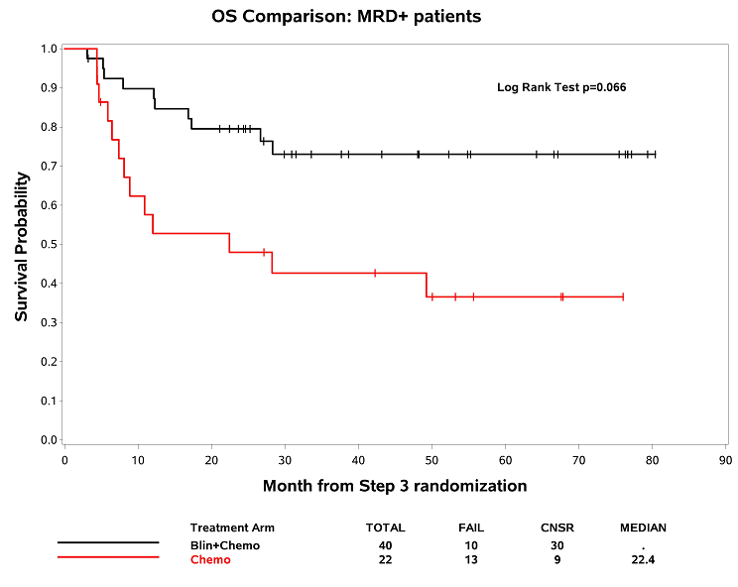
Overall Survival Comparison: MRD positive patients
Median OS: not reached (Blin + Chemo) vs. 22.4 months (Chemo); Hazard ratio 0.39, 95% CI: 0.14-1.10; Log rank, p=0.066
Deaths on Blin + Chemo Arm=9 (2° to ALL=6, NRM=1, Unknown=3), Chemo Arm=13 (2° to ALL=7, NRM=6)
Reproduced with permission from Litzow MR, et al. Presented at: American Society of Hematology Annual Meeting; December 10-13, 2022; New Orleans, LA, USA.

Slide 22
Conclusions
In the phase III randomized ECOG-ACRIN & NCTN trial E1910, consolidation with blinatumomab combined with chemotherapy has shown for the first time an overall survival advantage for adult patients with MRD-negative BCR::ABL negative B lineage acute lymphoblastic leukemia
The combination was in general well tolerated with no new safety signals reported
These results represent a new standard of care for this group of patients
Reproduced with permission from Litzow MR, et al. Presented at: American Society of Hematology Annual Meeting; December 10-13, 2022; New Orleans, LA, USA.

Slide 23
ACKNOWLEDGMENTS
Elisabeth Paietta, PhD; MRD studies
Zhuoxin Sun, PhD, statistician
Yanming Zhang, MD; cytogeneticist
Ryan Mattison, MD; study co-chair
Martin Tallman, MD; committee chair
Selina Luger, MD; committee co-chair
M. Wieduwilt, MD; M. Liedtke, MD; J. Bergeron; Alliance, SWOG & CCTG co-chairs, resp.
Gerhard Zugmaier, MD and colleagues at Amgen
NCTN colleagues who accrued to the study
Patients and Families
Reproduced with permission from Litzow MR, et al. Presented at: American Society of Hematology Annual Meeting; December 10-13, 2022; New Orleans, LA, USA.

Slide 24
Single cycle of blinatumomab followed by high-dose chemo in the induction therapy for (Ph-) all in adults. Primary endpoint analysis of the blina-cell trial
Cyril Salek^{1,2}, Frantisek Folber³, Stepan Hrabovsky³, Zdenek Koristek⁴, Jan M Horacek^{5,6}, Eva Fronkova⁷, Petr Soukup¹, Katerina Benkova⁴, Petr Cetkovsky^{1,8}, Jan Trka⁹, and Michael Doubek³
¹ Institute of Hematology and Blood Transfusion, Prague, Czech Republic; ² Charles University, First Faculty of Medicine, Prague, Czech Republic; ³ Department of Internal Medicine - Hematology and Oncology, University Hospital and Faculty of Medicine, Masaryk University, Brno, Czech Republic; ⁴ Department of Hematooncology, University of Ostrava, Faculty of Medicine, Ostrava, Czech Republic;
⁵ Department of Internal Medicine IV – Hematology, University Hospital Hradec Kralove, Hradec Kralove, Czech Republic; ⁶ Internal Medicine, University of Defence, Faculty of Military Health Sciences, Hradec Kralove, Czech Republic; ⁷ CLIP, Dept. of Paediatric Haematology and Oncology, Second Faculty of Medicine, Charles University and University Hospital Motol, Prague, Czech Republic;
⁸ Institute of Clinical and Experimental Hematology, Charles University in Prague, First Faculty of Medicine, Prague, Czech Republic; ⁹ CLIP - Childhood Leukaemia Investigation Prague, Department of Pediatric Hematology and Oncology, Second Faculty of Medicine, Charles University and University Hospital Motol, Prague, Czech Republic

Slide 25
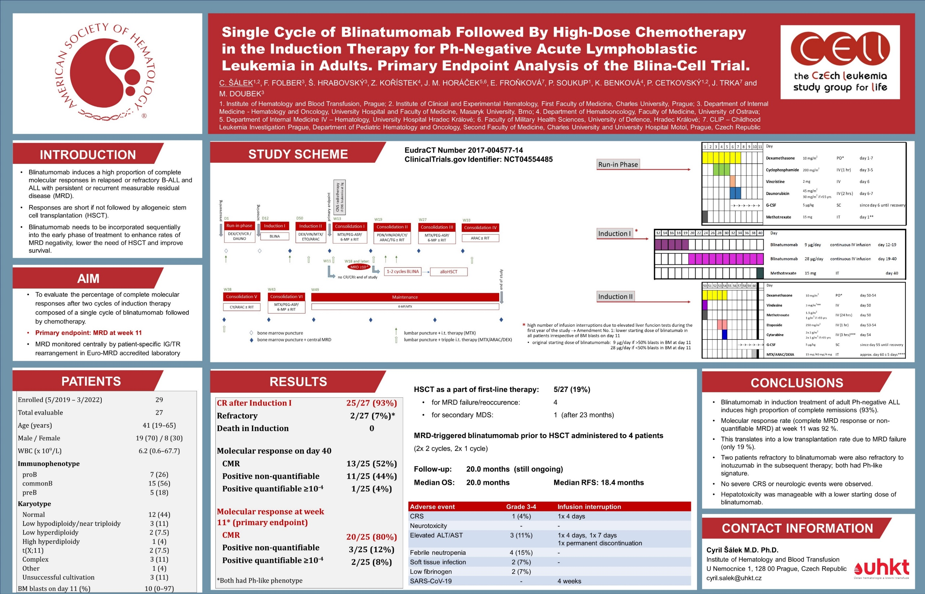
26

Slide 26
Amgen Sponsored B-ALL Studies
Notes:
26

Slide 27
Patient Characteristics, Treatment Patterns, and Cost Variations By Race/Ethnicity Among Adults with Relapsed or Refractory ALL Initiating First Salvage Therapy
Megan C Braunlin¹, Tingting Gong², Rebecca Payne³, Chuanyu Kou², Babatunde Adedokun¹, Kelly Velasco⁴, and Shuling Li²
¹ Center for Observational Research, Amgen Inc., Thousand Oaks, CA; ² Chronic Disease Research Group, Minneapolis, MN; ³ SimulStat, Solana Beach, CA; ⁴ Medical Affairs, Amgen Inc., Thousand Oaks, CA.

Slide 28
24

